Slide 1
Web3.js and Ether.js
Libraries that allows developers to interact with the Ethereum blockchain.

Slide 2
What is web3.js ?
Web3.js is a collection of libraries that allow developers to interact with a remote or local Ethereum node using HTTP, IPC, or WebSocket.
Using this library, you can develop websites or clients that interact with the blockchain.
This can be actions like sending Ether from one user to another, checking data from smart contracts, creating smart contracts, among other things.

Slide 3
Web3 Modules
web3.eth: This module is used to connect Ethereum blockchain and smart contracts. It also allows you to subscribe to events on the blockchain.
web3.eth.getBalance allows you to get the ETH balance of an address at a given block
web3.eth.signTransaction allows you to sign a transaction.
2. web3.shh: This module allows communication to the Whisper ( a communication technique dApps use to communicate with each other) protocol.
web3.shh.post posts a whisper message to the network
3. web3.utils: This module provides utility functions for Ethereum dApps and other web3 packages.

Slide 4
Web3 Modules
4. web3.bzz : allows you to interact with Swarm.
Swarm is a decentralized storage platform and content distribution service—it can serve as a place to store files like images or videos for your decentralized application (dapp).
web3.bzz.upload allows you to upload files and folders to Swarm.
5. web3.net :
allows you to interact with the network properties of an Ethereum node.
web3.*.net.getID returns the network ID
web3.* .net.getPeerCount returns the number of peers that the node is connected to

Slide 5
Uses of Web3.js
Smart Contract Interaction: Web3.js enables you to deploy and interact with smart contracts on the Ethereum blockchain. You can send transactions to smart contracts, call their functions, and retrieve data from them.
Blockchain Data Access: Web3.js provides access to blockchain data such as block information, transaction details, and token balances. Developers can use this data to build various applications, including blockchain explorers.
Decentralized Applications (DApps): Web3.js is a fundamental tool for building DApps on Ethereum. You can use it to create front-end interfaces that interact with smart contracts and interact with the blockchain seamlessly.

Slide 6
Token Transfers: Many cryptocurrencies and tokens are built on the Ethereum blockchain. Web3.js allows you to transfer Ethereum and ERC-20 tokens between accounts and contracts.
Gas Estimation: Before sending a transaction on Ethereum, it's essential to estimate the required gas. Web3.js provides functions to estimate gas costs, ensuring efficient use of resources.

Slide 7
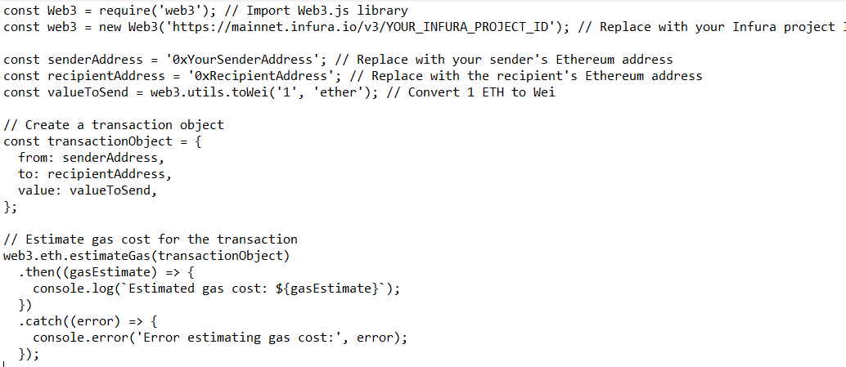
Example of how to estimate gas costs for a transaction using Web3.js

Slide 8
We import the Web3.js library and create a Web3 instance connected to the Ethereum mainnet via Infura. Make sure to replace 'https://mainnet.infura.io/v3/YOUR_INFURA_PROJECT_ID' with your Infura project ID or your Ethereum node URL.
We specify the sender's Ethereum address (senderAddress), the recipient's Ethereum address (recipientAddress), and the amount of Ether to send (valueToSend). Here, we're sending 1 Ether.
We create a transaction object with the sender, recipient, and value.
We use the web3.eth.estimateGas() function to estimate the gas cost for the transaction. The estimated gas cost is then printed to the console.

Slide 9
Pros and Cons of Web3.Js
Pros
Web3.Js is a versatile library with many advantages over Ethers.js.
It is more user-friendly, making it easier to get started with.
It also has a larger community of developers, which means more support is available online.
Cons
Web3.Js is less mature than Ethers.js and may not be as stable.
It also lacks some of the features available in Ethers.js.

Slide 10
What is Ether.js ?
Allows developers to interact with the Ethereum blockchain.
The library includes utility functions in JavaScript and TypeScript, and has all the capabilities of an Ethereum wallet.
Uniswap is one of the most notable platforms which use Ethers.js.

Slide 11
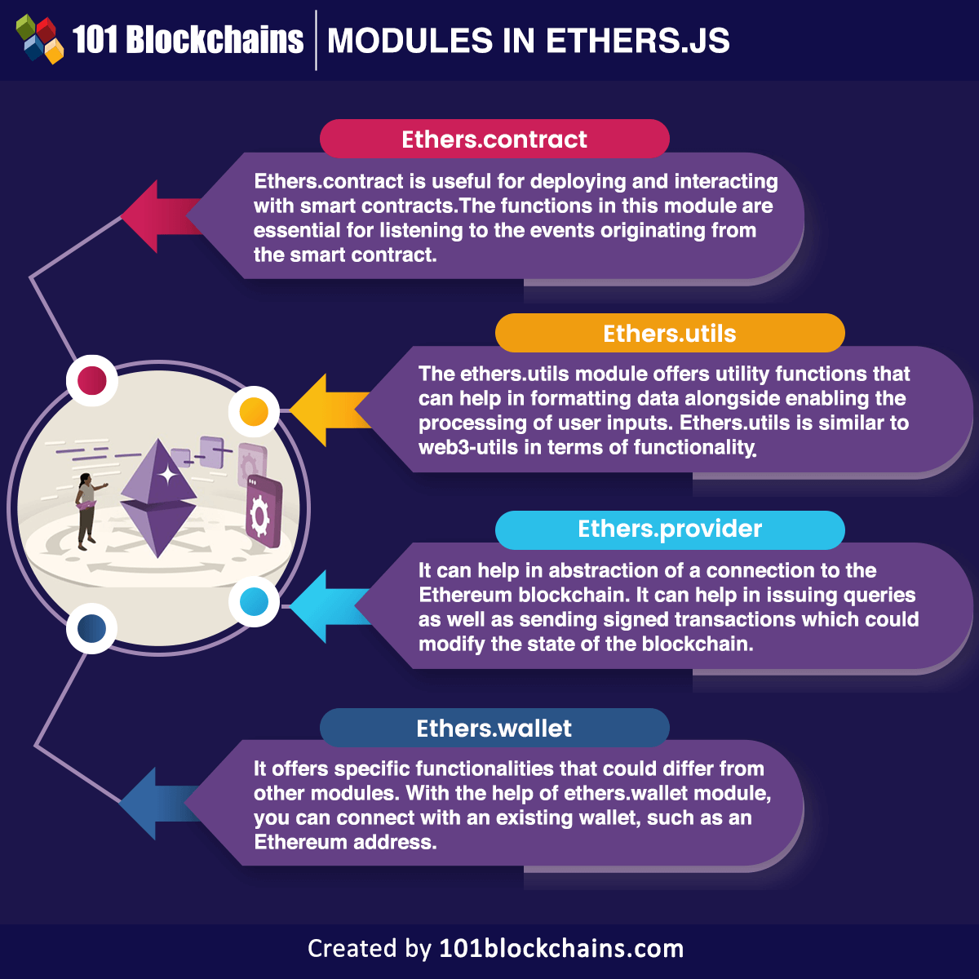

Slide 12
Modules in ether.js library
Ethers.contract
This module is used to deploy and interact with smart contracts. It offers the ability ( packed functions) to listen to smart contract events. However, you can use this module to call for information about a smart contract and the functions provided by the smart contract.
Ethers.utils
This module can help you format data like a wallet’s balance figure and process other user input. In the code below, after getting the address from a wallet, we retrieve the wallet’s balance, but since the returned value is outputted in Wei, we use the .formatEther to make it more human readable..

Slide 13
Ethers.provider
It can help in the abstraction of a connection to the Ethereum blockchain.
it can help in issuing queries as well as sending signed transactions which could modify the state of the blockchain. The examples of using ethers.provider module could help in determining how it serves a functional role in web3 development.
ethers.providers.InfuraProvider allows you to connect to the Infura hosted network of Ethereum nodes
ethers.provider.getBalance will get you the ETH balance of an address or a block in the blockchain
Ethers.wallet
With the help of ethers.wallet module, you can connect with an existing wallet, such as an Ethereum address. In addition, the module also helps in creating a new wallet alongside signing transactions.
ethers.wallet.getBalance will give us the ETH balance of a wallet address.

Slide 14
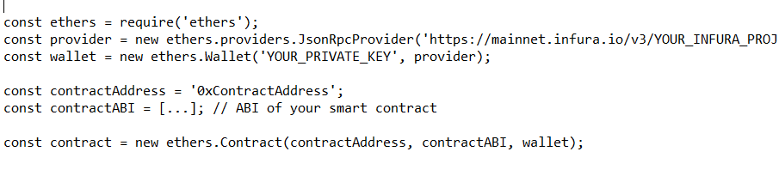
Use of Ether.js
Some common use cases and examples of how Ether.js can be used
Interacting with Smart Contracts: Ether.js simplifies the process of interacting with Ethereum smart contracts. You can use it to deploy smart contracts, send transactions to contract functions, and read data from contracts.

Slide 15
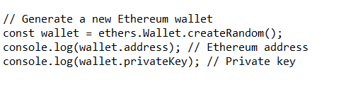
Creating Ethereum Wallets: Ether.js allows you to generate Ethereum wallets and manage them.
3. Transaction Handling: You can use Ether.js to send Ethereum transactions, check transaction status, and manage gas costs.

Slide 16
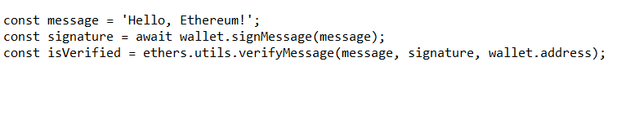
4. Signing and Verifying Messages: You can use Ether.js to sign and verify messages for various purposes, including authentication and message integrity.

Slide 17
Pros and cons
Pros
On the plus side, Ethers.js allows you to write Ethereum smart contracts in JavaScript directly in the browser, making it simpler and more accessible than other Blockchain languages.
It also has more robust support for wallets and authentication than Web3.Js.
Cons
Ethers.js can be limiting because of its focus on the Ethereum Blockchain only, while Web3.Js is more versatile since it supports multiple networks.
In addition, some Ethereum-specific features of Web3.Js are not available in Ethers.js.

Slide 18
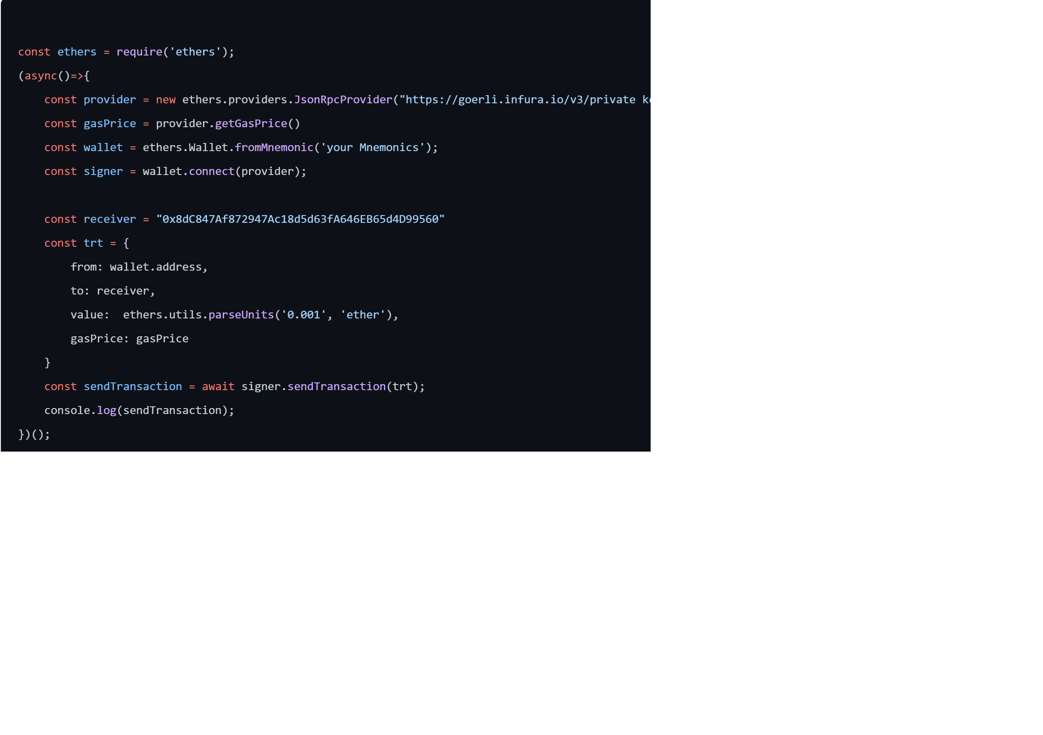
Comparision by code
Using Ether.js

Slide 19
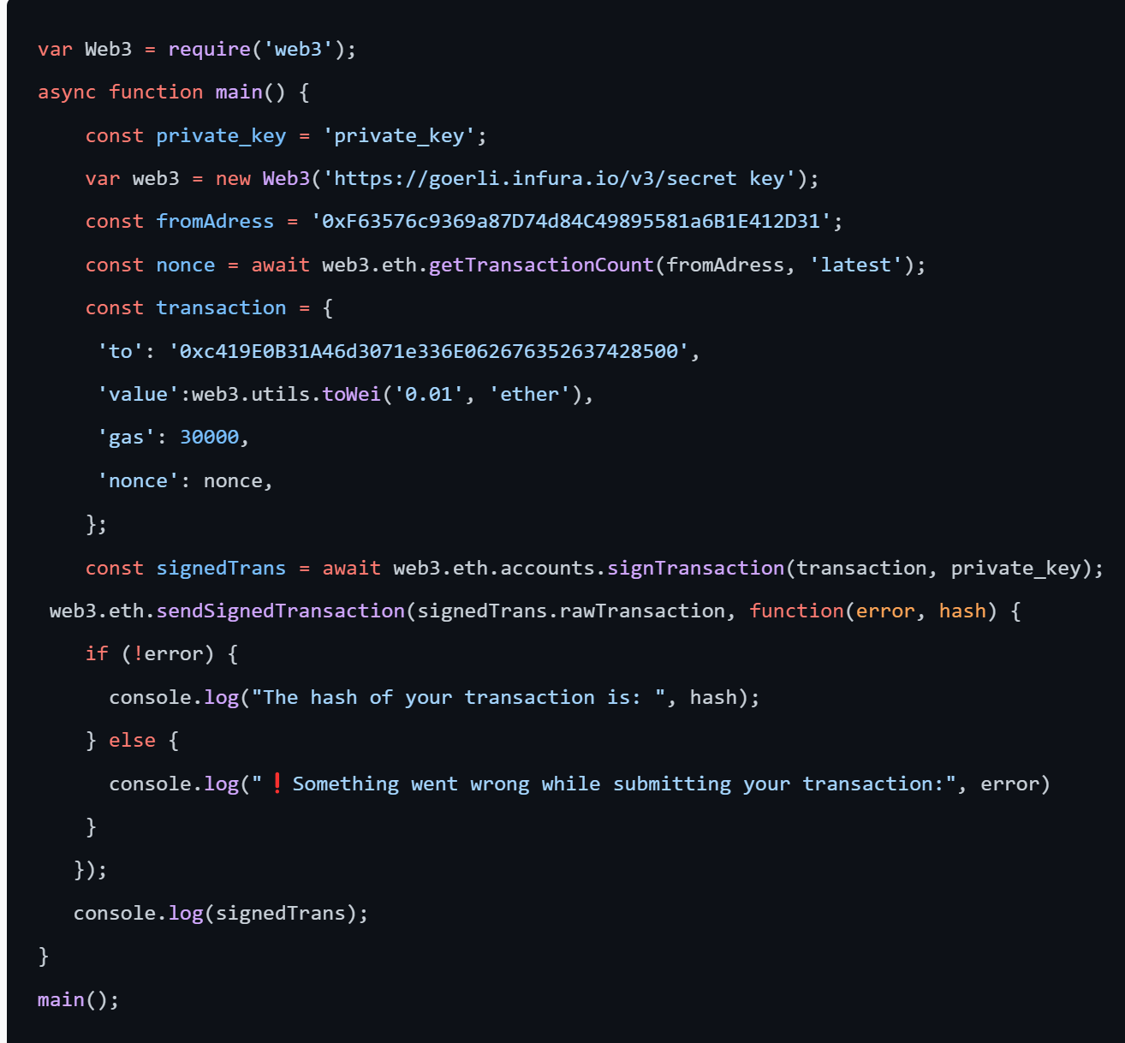
Using Web3.js

Slide 20
Main difference between two is…
Syntax: Ethers.js uses a more object-oriented syntax, while web3.js uses a more functional syntax.
Provider: Ethers.js uses a JsonRpcProvider class to connect to an Ethereum node, while web3.js uses the Web3 class.
Wallet: Ethers.js uses the Wallet class to create a new wallet or import an existing one, while web3.js uses the eth.accounts object to create a new wallet
Signing Transactions: In Ethers.js, the signer object is used to sign the transaction, while in web3.js, the eth.accounts.signTransaction function is used.
Sending Transactions: In Ethers.js, the send transaction method is called on the signer object to send the transaction, while in web3.js, the web3.eth.sendSignedTransaction function is used to send the transaction.
Gas Price: In Ethers.js the gas price is obtained by calling the getGasPrice method on the provider object, while in web3.js it is defined in the transaction object.

Slide 21
Topics to be covered in upcoming session
IPFS
Handling blockchain transactions on the backend.
Handling events of smart contract
Error and exception handling
APIs creation and integration

Slide 22
THANK YOU

